Slide 1

Powering the Future: Building a Dyson Sphere for AI Compute
Introducing an innovative solution to provide abundant energy for the growing AI industry - the Dyson Sphere.

Slide 2
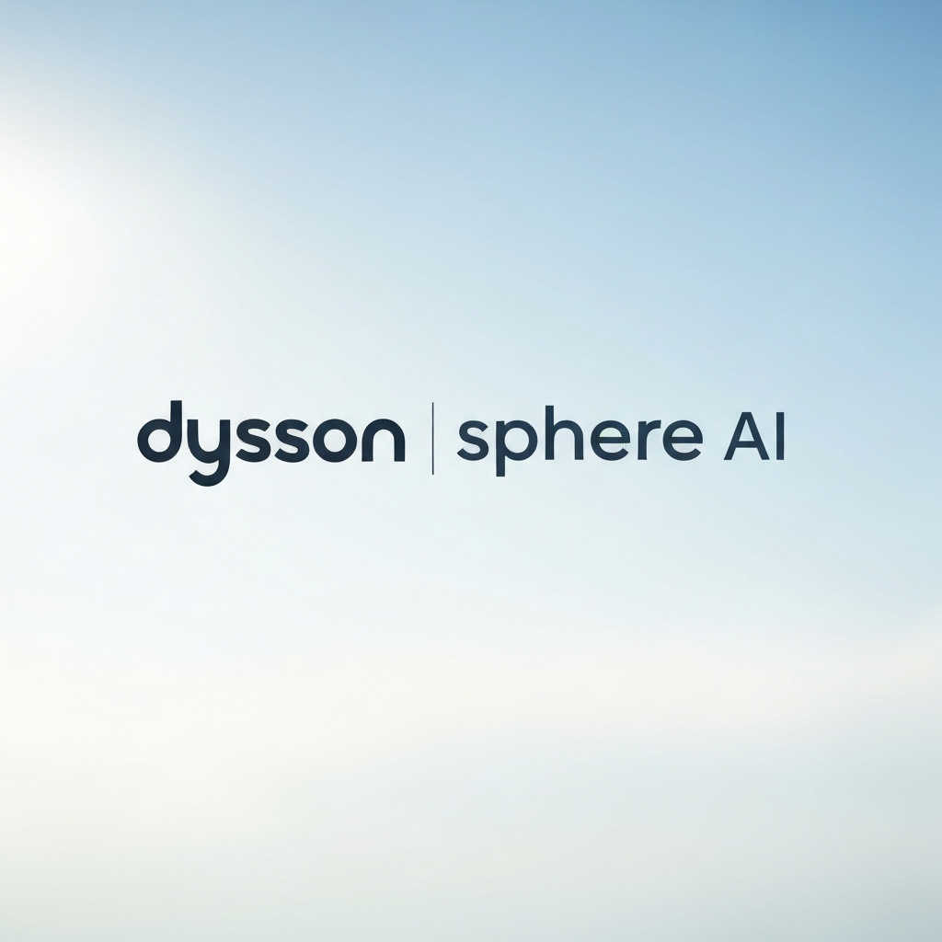
Dyson Sphere AI
A revolutionary startup aiming to build a Dyson sphere to power the exponential growth of AI compute and innovation.

Slide 3
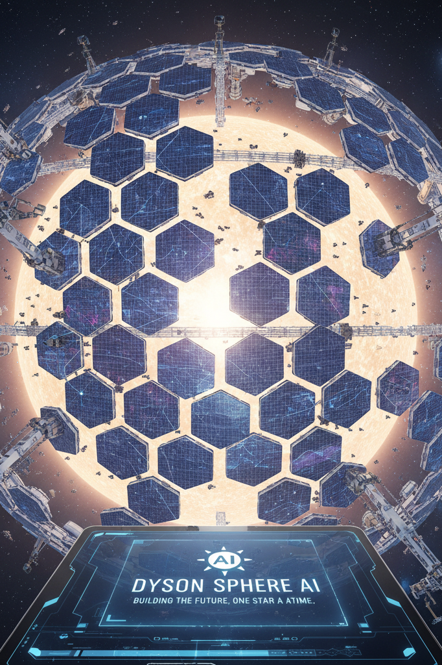
The Vision: A Dyson Sphere for AI
Harnessing the immense power of the sun, our Dyson Sphere technology aims to revolutionize the future of AI compute. By encapsulating the sun within a vast network of solar collectors, we will channel this boundless energy to fuel the exponential growth of artificial intelligence, unlocking unprecedented computational power to drive innovation and progress.

Slide 4
Dyson Sphere Technology
Harnessing the Power of the Sun
Advanced Thermal Management
Modular and Scalable Design
Our Dyson Sphere is designed to harness the immense energy of the sun, capturing and converting it into clean, sustainable power to fuel our AI compute needs. By encapsulating the sun in a network of interconnected panels, we can maximize energy collection and distribution.
Keeping the Dyson Sphere operational and efficient requires sophisticated thermal management systems. We utilize cutting-edge heat exchange mechanisms, advanced cooling systems, and specialized materials to ensure the Dyson Sphere can withstand the intense heat and radiation of the sun.
Our Dyson Sphere design is highly modular, allowing for easy scaling and expansion as our energy demands grow. The individual panels and components can be seamlessly integrated, enabling us to build and deploy the Dyson Sphere in a phased approach to meet the increasing needs of the AI industry.
Integrated Energy Storage
Autonomous Maintenance and Monitoring
To ensure a reliable and consistent power supply, our Dyson Sphere design incorporates advanced energy storage solutions. This includes high-capacity battery banks and cutting-edge energy storage technologies to buffer and distribute the collected solar energy as needed, even during periods of reduced sunlight.
The Dyson Sphere will be equipped with state-of-the-art autonomous monitoring and maintenance systems. These systems will continuously track the performance, health, and efficiency of the Dyson Sphere, enabling us to proactively address any issues and optimize energy generation and distribution.

Slide 5







The Growing Demand for AI Compute
Annual Growth in AI Workloads
Increase in Energy Consumption by AI Centers
Projected Rise in Global AI Compute Demand
Anticipated AI Market Size by 2025

Slide 6





Our Experienced Team
Dr. Amelia Hawking
Elon Jatinder
Sakshi Gupta
Dr. Liam Nguyen
Samantha Zhao
Co-founder and Chief Scientist
Co-founder and Chief Executive Officer
Chief Technology Officer
Lead Aerospace Engineer
Chief Financial Officer

Slide 7
Roadmap to Success
Q4 2023
2025
Achieve first energy generation from Dyson Sphere and begin integration with AI compute infrastructure
Expand Dyson Sphere network to multiple locations and maintain 99.99% uptime for AI compute operations
Q1 2023
Finalize Dyson Sphere design and engineering blueprints
2024
Q2-Q3 2023
Scale up Dyson Sphere production and deploy full-scale solution to power growing AI compute needs
2026
Commence construction of Dyson Sphere prototype and begin testing
Establish Dyson Sphere AI as the leading provider of renewable energy for the global AI industry

Slide 8
Funding and Investment Opportunities
Funding Overview
We are currently seeking $1.5 million in pre-seed funding to kickstart the development of our revolutionary Dyson Sphere technology for AI compute.
Investment Opportunity
By investing in Dyson Sphere AI, you have the opportunity to be a part of the solution that will transform the future of energy and power the next generation of AI innovation.
Returns and Impact
Your investment will not only provide strong financial returns, but it will also have a lasting impact on the energy landscape, enabling a sustainable future for AI compute and powering the technologies that will shape our world.
Milestones and Roadmap
We have a well-defined roadmap with key milestones that will guide us to the successful deployment of our Dyson Sphere, ensuring that your investment is put to work efficiently and effectively.
Join the Revolution
Invest in Dyson Sphere AI and be a part of the solution that will revolutionize the future of energy and AI compute. Together, we can shape the energy landscape for generations to come.

Slide 9
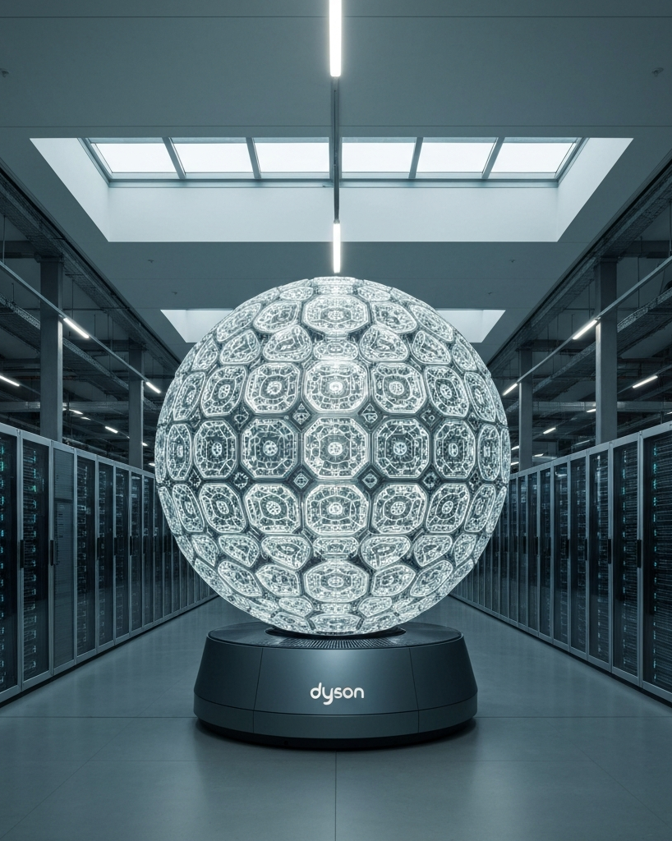
Join us in powering the future of AI compute with Dyson Sphere AI's revolutionary technology. By investing in our ambitious Dyson sphere project, you'll be a part of the solution that will transform the global energy landscape and fuel the AI revolution for generations to come. With our experienced team, cutting-edge engineering, and robust roadmap, we are poised to deliver on the promise of limitless, sustainable energy to power the exponential growth of AI.

